Slide 1
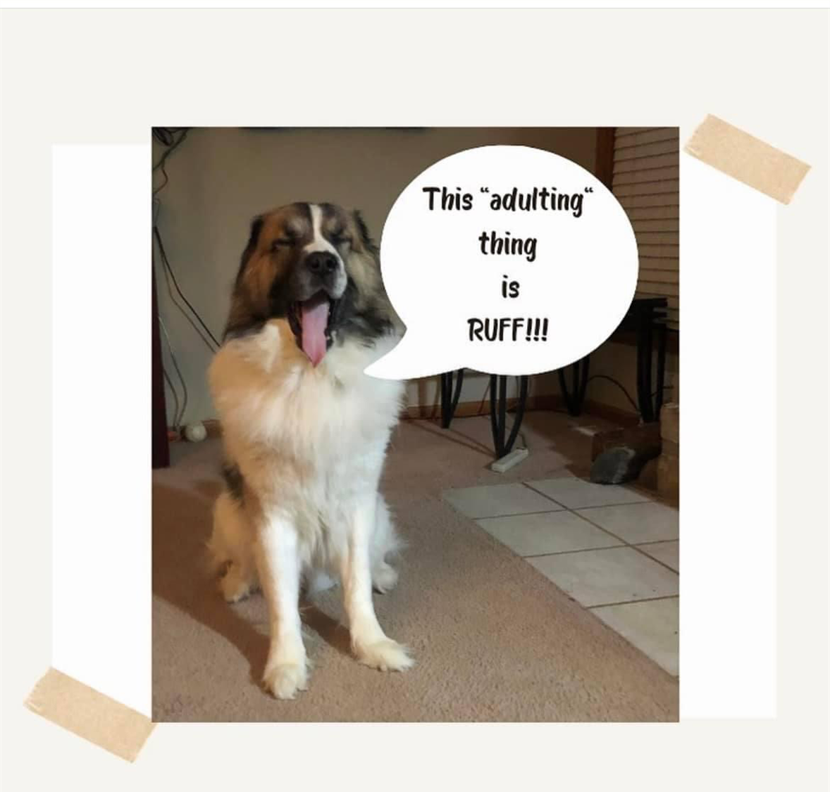
Social Security Benefits…
Transition to Adulthood Family Education Day
Children’s Mercy CMRI
Kansas, City MO
June 10, 2023

Slide 2
What We Will Cover Today:
Overview of SSI/SSDI
Differences Between SSI/SSDI
Eligibility
Things That Affect Benefit Amount
Tips for initial SSI application at 18
Tips for SSI Redetermination application for transition from childhood to adulthood

Slide 3

Let’s Get Started, Shall We??????

Slide 4
Social Security disability benefits are paid through two basic programs:
– SSI – Supplemental Security Income.
– Title II Disability Benefits – often referred to simply as “disability” or SSDI.

Slide 5
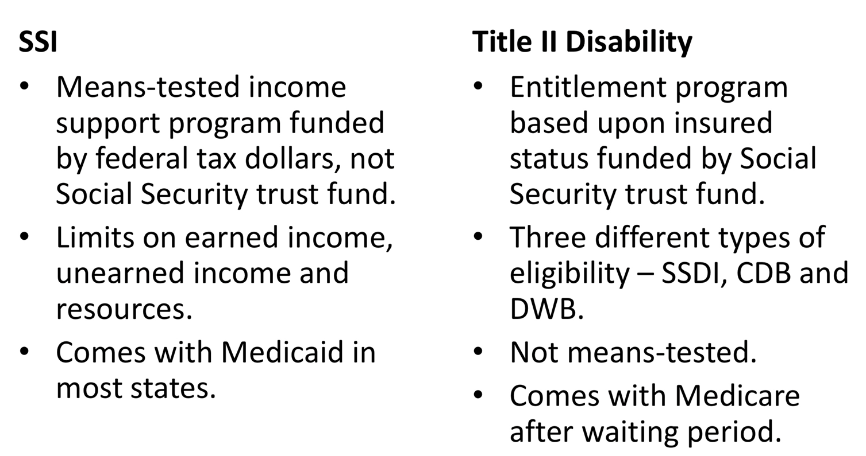
Differences between SSI and SSDI (Title II Disability)

Slide 6
Eligibility for Social Security Disability Benefits (Title II)
• Not be working or earnings are under SGA limit ($1,470 and $2460 for blind)
Have earned enough “credits” by paying into the system, have a deceased, retired or disabled parent who paid in on your behalf (CDB)
• Resources and most other forms of unearned income not considered.

Slide 7
Childhood Disability Benefits (CDB)
To be eligible for Social Security Disability (SSDI) as an adult child with a disability, individuals must be:
1. 18 years of age or older;
2.Disabled by Social Security’s definition before age 22; and
3. Child of an insured worker who is either disabled, retired or deceased.

Slide 8
Eligibility for SSI
• Federal Benefit Rate maximum of $914
Countable resources under $2,000 (individual)
• Have unearned income of less than the current Federal Benefit Rate ($914).
• Parental income counts for children under 18. This process is known as “deeming”.

Slide 9
Things That Can Affect SSI Amount
Earned Income–wages, net earnings from self- employment,
in-kind items in lieu of pay.
• Unearned income.
• In-kind support & maintenance -1/3 reduction rule ($609 in 2023)
• Overpayment recovery (10%).

Slide 10
A Word About SSI and Work Under 22
A blind or disabled child, who is a student regularly attending school, college, or university, or a course of vocational or technical training, can have limited earnings that are not counted against his or her Supplemental Security Income (SSI) benefits.
Income Exclusion Amounts for 2023
For 2023, the student earned income exclusion amounts are $2,220 per month but not more than $8,950 in 2023.

Slide 11


Slide 12
Special Issues for Transition Age Youth
SSI recipients must undergo the age 18 redetermination for benefits to continue under the adult standard.
• Parent-to-child deeming in the SSI program stops at the 18th birthday.
•Eligibility for Social Security child’s benefits stops at 18 (or 19 years 2 months if still in high school).
• Eligibility for CDB may begin at the age of 18 if the disability standard is met.
• Youth who work may establish eligibility for SSDI quickly.

Slide 13
Redetermination for SSI from a child to adult
Adult definition of disability different than child’s definition for SSI – more stringent.
• For SSI to continue after age 18, individuals must meet the adult definition of disability.
• Approximately 45% of SSI recipients are initially found ineligible to continue SSI benefits after age 18.

Slide 14
More about Age 18 Redetermination
The re-determination may be conducted at anytime after 18th birthday. Usually it is done before the person turns 19.
• If found ineligible, payments are due for two months beyond the month in which the disability determination was made. The determination is NOT retro-active to the 18th birthday.

Slide 15
Things to Remember for 1st Time Applicants at 18:
Try to schedule your interview with Social Security to take place immediately after your child turns 18.
You may want to call before the child’s birthday, however the interview will not be able to take place until the child is 18.
A person may not have more than $2000 in assets to be eligible for SSI. Adjustments may have to be made five years prior to age 18. Be sure to alert other family members not to give large gifts of money or stocks directly to your young adult directly or in their wills.
It may also be appropriate to collect monthly room and board from your young adult who will receive SSI and continue to live with you at home because this will establish a pattern of their paying a portion of their benefits towards monthly rent in preparation for them moving into their own housing.

Slide 16
TIPS on Application Process
Respond promptly if the disability examiner contacts you for additional information or requests your contact.
Keep copies of all paperwork sent to the Social Security office or DDS in case of loss or non-receipt.
Read and follow the instructions carefully when submitting documents and forms to the disability determination services
Complete activities of daily living and work history forms in a timely manner to avoid delays, but don't rush through them.
Provide a third-party contact in case the disability examiner cannot reach you directly.
Inform your doctors about your disability application.
Submit relevant medical records, including physical and mental examinations, test scores, IEP, and report cards if available.
Provide comprehensive documentation for your claim, listing all impairments and relevant details about your medical treatment.
Document your medical history in detail, including treatment dates and contact information for healthcare providers.
If your initial claim is denied, file for reconsideration promptly, ensuring the appeal is received within 60 days of denial plus five additional days for mailing. Include any relevant new information or changes in your appeal paperwork.

Slide 17
GREAT OVERVIEW FROM SSA
https://www.ssa.gov/pubs/EN-05-11005.pdf

Slide 18
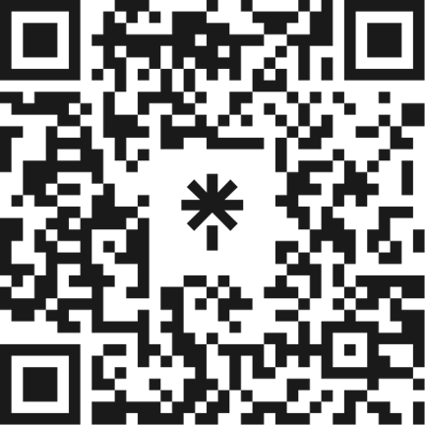
Questions?
Seek out the assistance of a credentialed benefits planner, special needs financial planner, etc.
Plan ahead! Contact us: info@hulmeresources.com
Jackson County and Platte County funding for FREE initial benefits planning supports
Waiver funding for supports

