Slide 1
MO Medicaid Waivers Deep Dive
Presented by:
Gregg Aultman, Service Coordination Supervisor
Tessa Gerhart, Service Coordination Supervisor

Slide 2
Objectives
After today, you will be able to:
Identify what a Medicaid Waiver is and who is eligible
Identify the 11 Missouri Medicaid Waivers
Identify services available through the various Missouri Medicaid Waivers

Slide 3
What is a Medicaid Waiver?
And who is eligible?

Slide 4
What is a Medicaid Waiver?
Omnibus Reconciliation Act of the Social Security Act (PL97-35)
Provide Home & Community-Based supports instead of institutionalization
Missouri HCBS Waivers from Section 1915(c)
Allows supports not otherwise covered by Medicaid
Medicaid/private insurance is always first payer

Slide 5
Eligibility
Must have Medicaid* and be assessed to determine they have a Level of Care that would typically require one of the following institutions:
Nursing facility
Hospital
Intermediate Care Facility for Developmental Disabilities (ICF/DD)

Slide 6
Eligibility
DHSS waivers are accessed by starting with an HCBS Intake Assessment
DD waivers are accessed through Support Coordinators after DD has determined an individual eligible.
Any individual may only participate in ONE (1) Medicaid waiver

Slide 7
Assessments
DHSS Assessments are more medical in nature
DMH/DD Assessments related to functional living/limitations.

Slide 8
DHSS Medicaid Waivers

Slide 9
DHSS Waivers

Slide 10
DHSS Waivers

Slide 11
DHSS Waivers

Slide 12
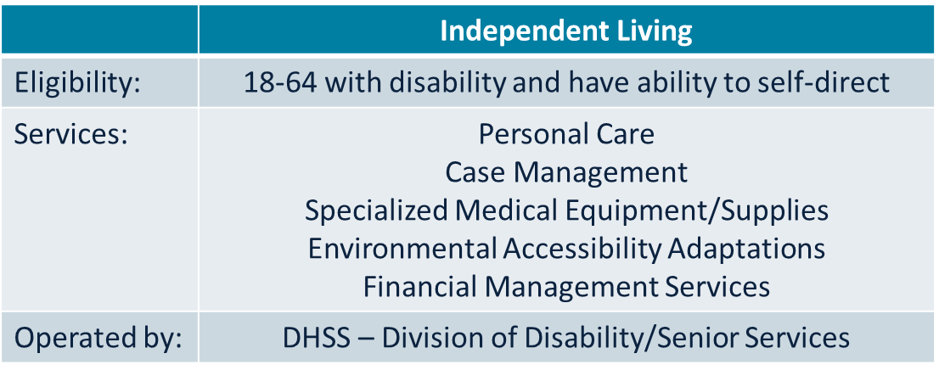
DHSS Waivers

Slide 13
DD Medicaid Waivers

Slide 14
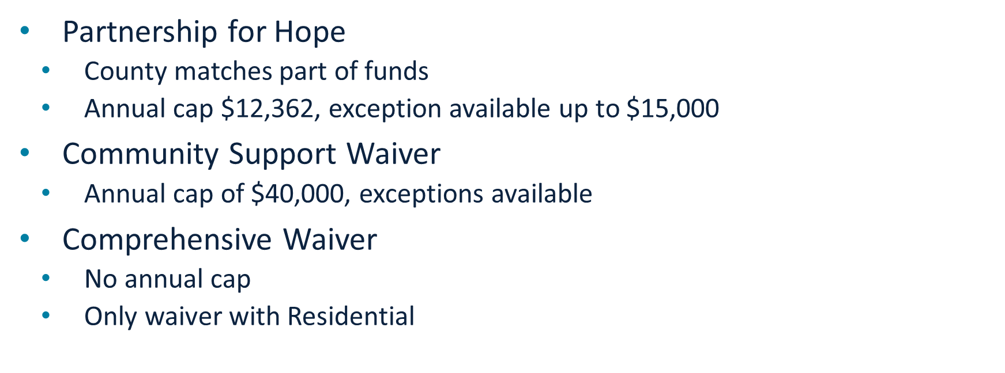
DD Waivers

Slide 15
DD Waivers
Missouri Children with Developmental Disabilities Waiver
(Sarah “Lopez” Waiver)
Family income too high to qualify for Medicaid normally
Significant medical or behavioral concerns/cost
Allows state to only view child’s income since family is choosing to keep them out of an institution
Valid only until age 18
No employment services available

Slide 16
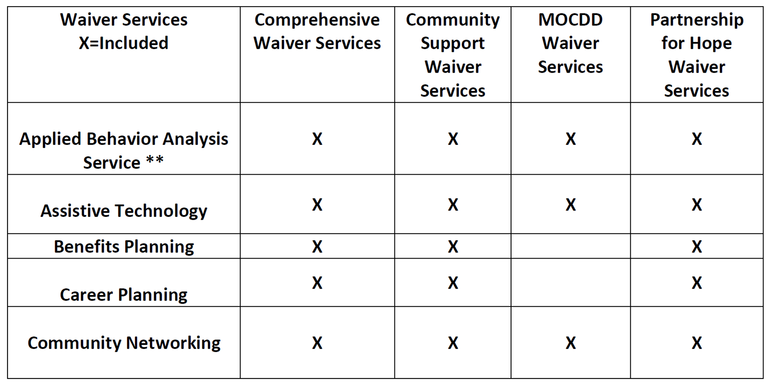

Slide 17
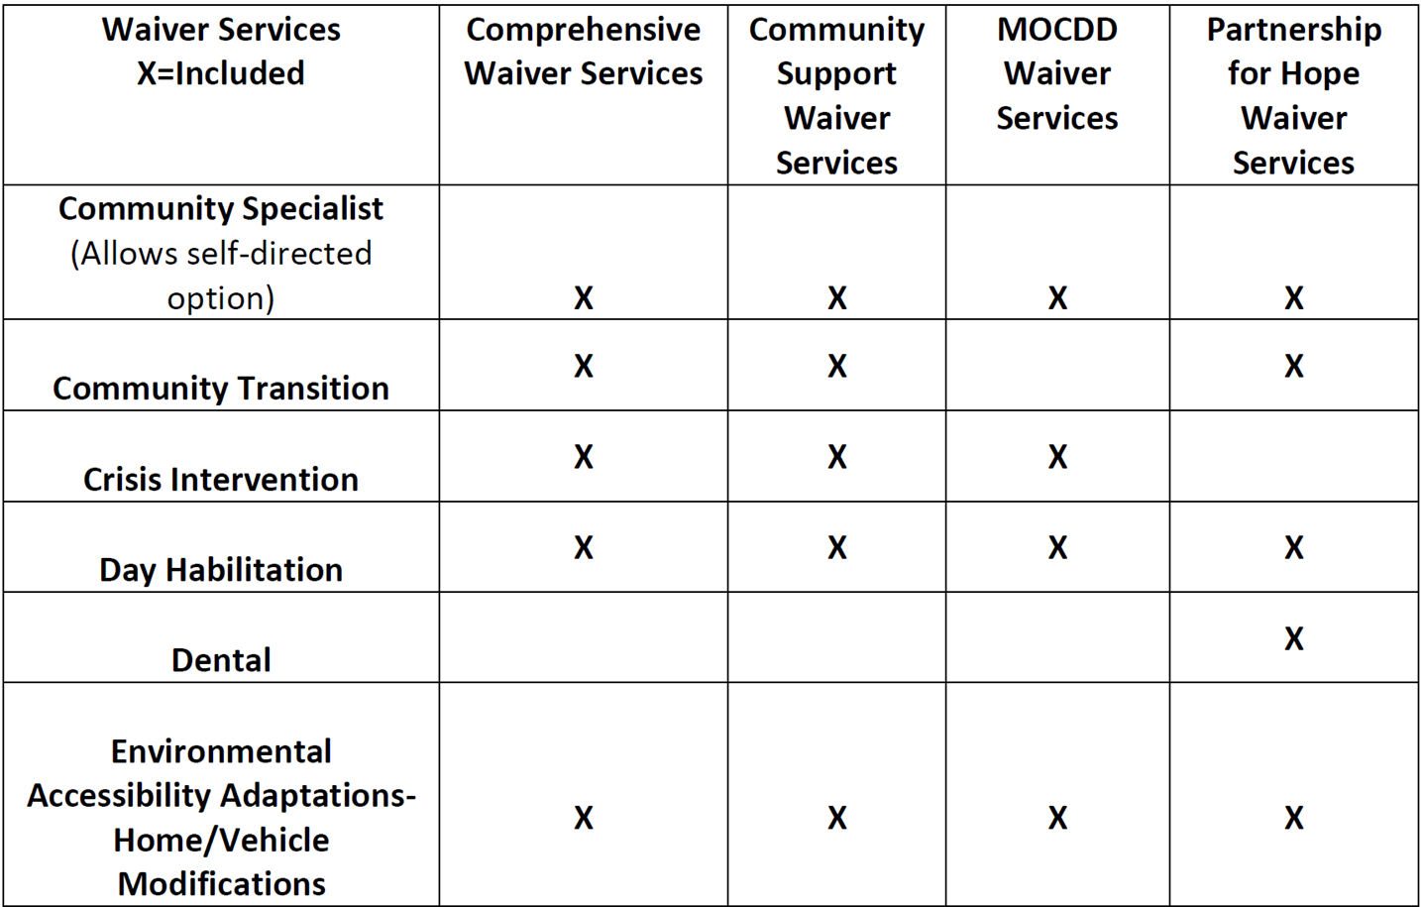

Slide 18
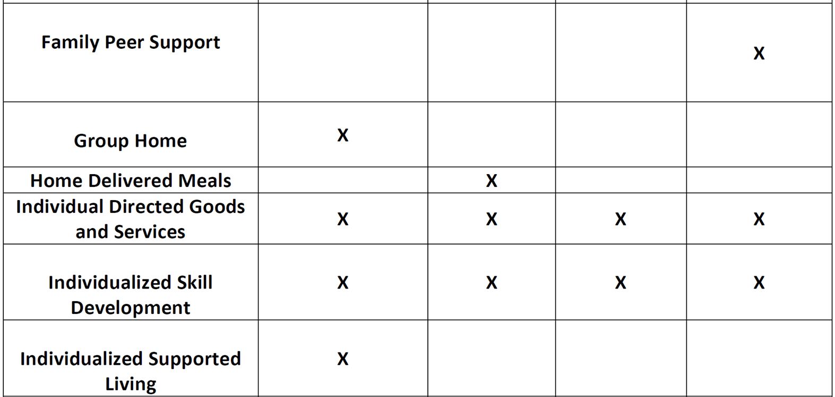

Slide 19
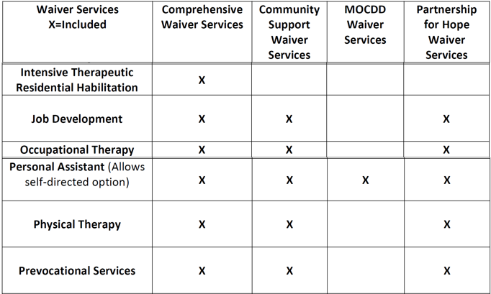

Slide 20
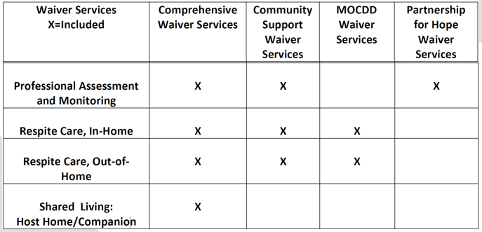

Slide 21
