Slide 1
A Deep Dive Into Kansas Medicaid Waiver, Supports and Services
Sean Swindler, M.S.Ed.
Kansas University Center on Developmental Disabilities
Kansas Center for Autism Research and Training

Slide 2
Special Education
Purpose of the IDEA:
“to ensure that all children with disabilities have available to them a free appropriate public education that emphasizes special education and related services designed to meet their unique needs and prepare them for further education, employment, and independent living.”
20 U.S.C. § 1400(d)(1)(A) (emphasis added).

Slide 3
Educational Transitions
Age 3: exit from Part C, Infant/Toddler Services
Age 5: entrance into kindergarten (full-day)
Grade 6: entrance into middle school
Grade 9/10: entrance into high school
Age 14 for Vocational Rehabilitation referral.
Grade 12: graduation from high school
Age 18-21: continued education at high school or specialty school
By Age 22: exit from public education

Slide 4
What is Transition?
Transition services are intended to prepare students to move from the world of school to the world of adulthood.

Slide 5
SpEd Transition Services
Transition services are “a coordinated set of activities”
To “facilitate the child’s movement from school to post-school activities, including post-secondary education, vocational education, integrated employment (including supported employment), continuing and adult education, adult services, independent living, or community participation;”
Are “based on the individual child’s needs, taking into account the child’s strengths, preferences, and interests; and
Include “instruction, related services, community experiences, the development of employment and other post-school adult living objectives, and, when appropriate, acquisition of daily living skills and functional vocational evaluation.”
20 USC 1401(34)

Slide 6
Transition Checklist
WHEN: 6 months prior to turning 18
Supplemental Security Income (SSI)
Monthly payment for people who meet eligibility – most people who have I/DD qualify, some people with Autism qualify
Most people who receive SSI are also Medicaid eligible
Prior to 18, children who qualify do not receive SSI unless FAMILY income meets guidelines
When your child turns 18, if they are SSI eligible, THEIR income (which is likely ZERO) is what counts for income eligibility

Slide 7
Transition Checklist
3. Vocational Rehabilitation and PRE-ETTS (Pre-Employment Transition Services)
Most people who are eligible for SSI are also eligible for VR. VR Can provide…
Pre-employment services (more on this!)
Job development
Job coaching
Pay for vocational training
Pay for degree seeking college programs
Assist with transportation and other things needed to achieve employment goals

Slide 8
Vocational Rehab
VR program provides services and supports to help people with disabilities:
“prepare for, secure, retain, advance in, or regain employment”
Rehabilitation Act, 2006, § 722 (a)(1)

Slide 9
Transition Checklist
3. PRE-ETTS (Pre-Employment Transition Services)
Eligibility:
The student is 16-21 years of age.
• The student is in a secondary, post-secondary or other recognized
education program.
• The student is eligible for, and receiving services under an Individual
Education Plan or 504 Plan, or the student is an individual with a
disability, as defined by Section 504 of the Rehabilitation Act.
• The student is a resident of Kansas.
Services are designed to provide an early start at
job exploration and to assist students with
disabilities in making the transition from
secondary to post-secondary education/training
and competitive, integrated employment

Slide 10
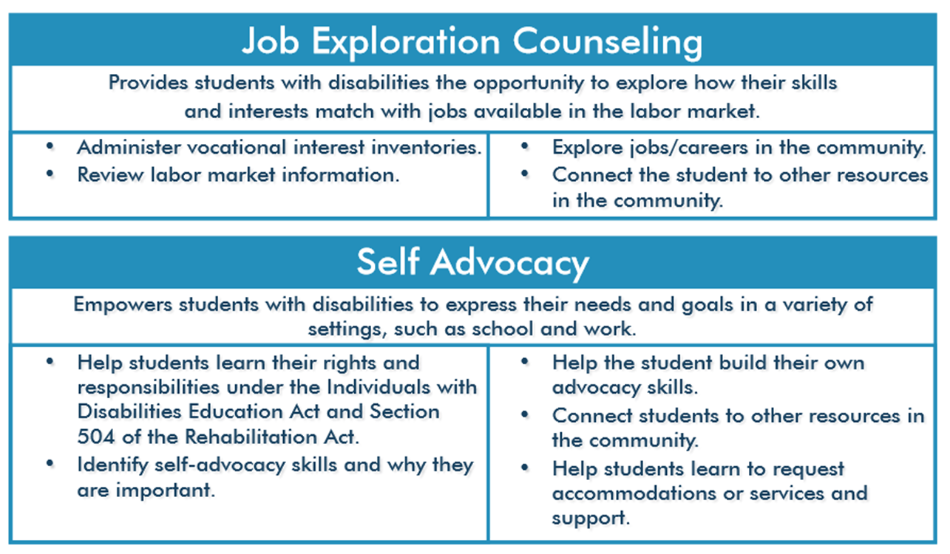
Transition Checklist
3. PRE-ETTS (Pre-Employment Transition Services)

Slide 11
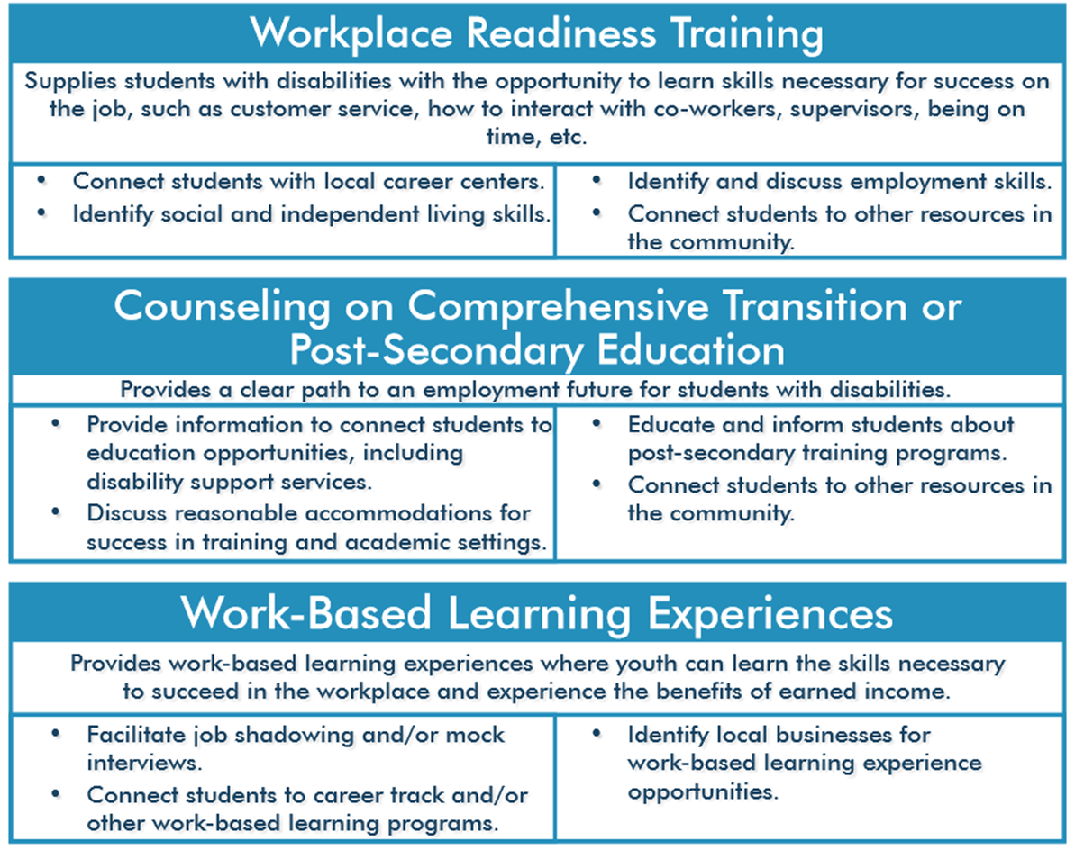
3. PRE-ETTS (Pre-Employment Transition Services)

Slide 12
Transition Checklist
New: STEPS program
STEPS is a program through KDHE and is facilitated by a Community Services Coordinator who helps participants prepare for employment, increase independence, receive and maintain health care coverage, and provide on-going supports to help maintain employment.
https://kancare.ks.gov/consumers/working-healthy/steps

Slide 13
Transition Checklist
New: STEPS program
The eligibility requirements for STEPS are as follows:
Must be a KanCare beneficiary aged 16 to 65, and
Must qualify under one of the following criteria:
  Individuals who receive SSI or SSDI and have one or more qualifying behavioral health diagnoses;
  Individuals who receive SSI and are waitlisted for the Physical Disability (PD) or Intellectual or Developmental Disability (I/DD) home and community-based services waiver; or
  Individuals who are current on the Brain Injury (BI), Physical Disability (PD), or Intellectual or Developmental Disability (I/DD) home and community-based services waiver who wish to leave their waiver to participate in STEPS.

Slide 14
Transition Checklist
WHEN: Age 5 (if possible) or anytime after
2. Kansas Intellectual and Developmental Disabilities Waiver
Disability manifests before age 22 and substantial limitation in 3 or more areas of life functioning
Community Developmental Disability Organizations (CDDO) are single point of entry
Can apply for services starting at age 5
BUT it is not unusual to discover during High School years that a person may be eligible
10 Year Waiting List for services

Slide 15
HCBS Waiver
A Home and Community Based Services (HCBS) waiver is an authorization from Medicaid that allows a beneficiary to receive treatment at home or in a community setting, rather than being required to enter an institution. The HCBS waiver program was initiated in the 1980s. Individual states administer their own waiver programs and have specific information on how to apply for their programs. Social workers and counselors can assist people with the process.
Historically, Medicaid only provided funding to institutions like nursing homes. People eligible for Medicaid who needed skilled nursing services, personal care, and related services were forced to enter institutions in order to access benefits.

Slide 16
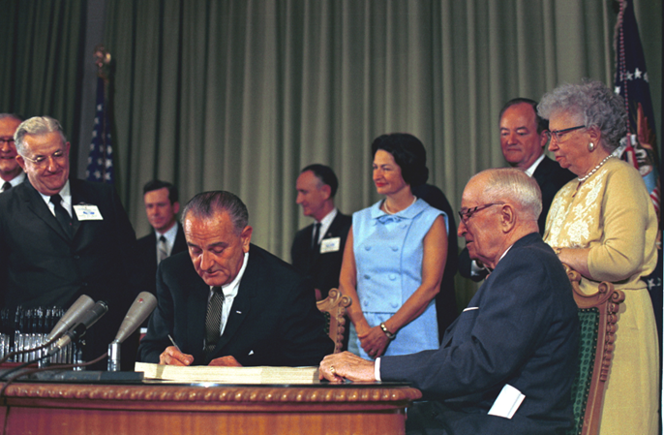
Medicaid
Above: President Lyndon Johnson signing Medicaid into law-1965, seated on the right is former President Harry Truman
Passed in 1965, provides federal funds matched by states to provide medical assistance to residents who cannot afford it

Slide 17
EPSDT
Early and Periodic Screening, Diagnostic and Treatment
Original part of Medicaid in 1967
Preventative treatment and comprehensive care
Provides comprehensive treatment for all medically-necessary

Slide 18
CHIP
Children’s Health Insurance Program (CHIP) signed into law at the federal level in 1997.
•Adopted in Kansas in 1998, implemented in 1999.
Covers children in families with incomes too high for Medicaid but who can’t afford private coverage.
Authorized by Congress through 2023.•Total cost of $17.5 billion nationally in 2017.

Slide 19
What is MANAGED CARE?
Managed care is a delivery system intended to manage cost, utilization and quality.
Medicaid and CHIP services can be provided through contracts between state agencies and managed care organizations (MCOs).
MCOs are paid per member/per month “capitation” payments that place them at risk for the cost of care.
MCOs contract with providers to deliver care.

Slide 20
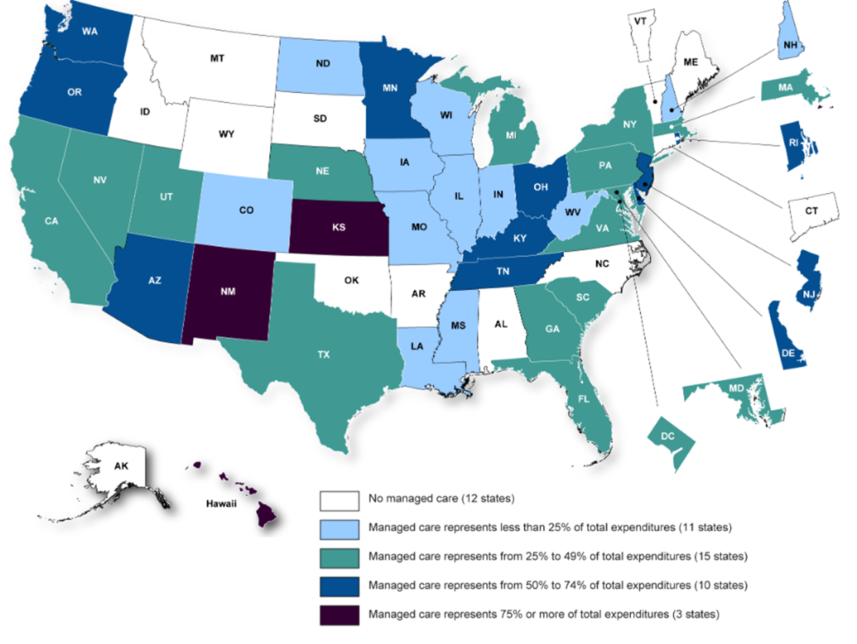
Medicaid Managed Care

Slide 21
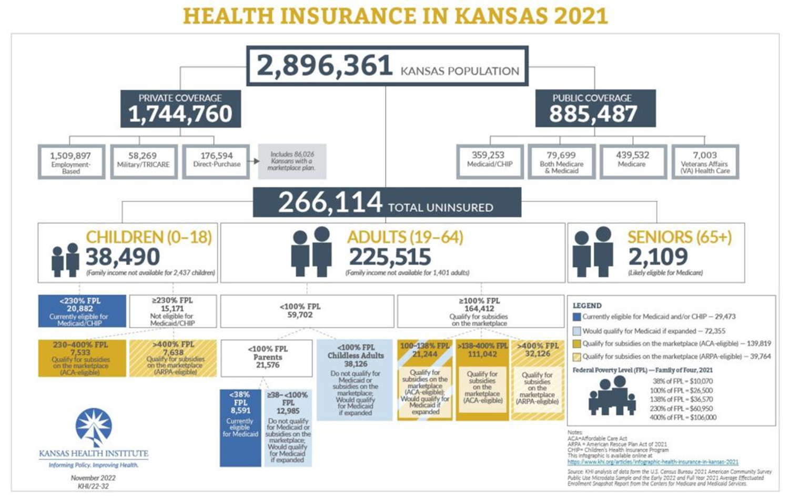

Slide 22
HCBS Waiver Requirements
State HCBS Waiver programs must:
Demonstrate that providing waiver services won’t cost more than providing these services in an institution
Ensure the protection of people’s health and welfare
Provide adequate and reasonable provider standards to meet the needs of the target population
Ensure that services follow an individualized and person-centered service plan

Slide 23
Kansas HCBS Waivers
Waivers are an agreement with CMS of what services and how we provide services to different populations.
These waiver applications cover everything from assessment, level of care (who, what, where and how)
To services, what services, duration amount and scope.
To ensuring health and welfare, program evaluation, appeal rights etc.,

Slide 24
Kansas Waivers
http://www.kdads.ks.gov/commissions/home-community-based-services-(hcbs)
Autism (AU) - child who starts services before age 6
Frail Elderly (FE) - 65+ years
Intellectual and Developmental Disability (I/DD) - 5+ years
Physical Disability (PD) - 16-64 years
Serious Emotional Disturbance (SED) - 4-18 years
Technology Assisted (TA) - 0-21 years
Traumatic Brain Injury (TBI) – 5-64 years

Slide 25
Medicaid Waivers
Medicaid Waiver programs help provide services to people who would otherwise be in an institution, nursing home, or hospital to receive long-term care in the community. Prior to 1991, the Federal Medicaid program paid for services only if a person lived in an institution.
The 1915(c) waiver is known as the “home and community-based services waiver” (HCBS) because it allows states to treat certain Medicaid populations in home or other community based settings rather than in institutional or long-term care facilities such as hospitals or nursing homes.

Slide 26
Kansas HCBS I/DD Waiver eligibility
Intellectual Disability // substantial limitations in present functioning that is manifested during the period from
birth to age 18 years and is characterized by significantly sub average intellectual functioning existing
concurrently with deficits in adaptive behavior including related limitations in two or more of the following
applicable adaptive skill areas:
Communication, self-care, home living, social skills, community use, self-direction, health and safety,
functional academics, leisure and work);
Or
(2) a severe, chronic disability, which:
Is attributable to a mental or physical impairment, or multiple sensory impairments, a combination
of mental and physical impairments, physical and sensory impairments, mental and sensory
impairments or a condition which has received a dual diagnosis of mental retardation and mental illness;
(B) is manifest before 22 years of age;
(C) is likely to continue indefinitely;
(D) results, in the case of a person five years of age or older, in a substantial limitation in three or more of
the following areas of major life functioning: Self-care, receptive and expressive language development and use,
learning and adapting, mobility, self-direction, capacity for independent living and economic self-sufficiency;
(E) reflects a need for a combination and sequence of special interdisciplinary or generic care, treatment,
specialized communications techniques or other services which are lifelong, or extended in duration and are
individually planned and coordinated; and
(F) does not include individuals who are solely and severely emotionally disturbed or seriously or persistently
mentally ill or have disabilities solely as a result of the infirmities of aging.

Slide 27
IDD: working with the Targeted Case Manager, MCO Care Coordinator, CDDO and CPA
Targeted case management services are … those … which … assist the beneficiary in gaining access to medical, social, educational, and other needed services.
The DD Case Manager provides:
  Assessments … to determine service needs (but not the functional assessment related to eligibility);
  Development of a specific support/care plan;
  Referral and related activities;
  Monitoring and follow-up activities.

Slide 28
CDDO Role
Offers local choice of services (regulatory role)
Quality assures service provision by local pro-viders
Tracks waiver and waitlist children and adults
Ensures that services are provided according to person-centered support plan
Ensures health, safety, welfare of people within catchment area.

Slide 29
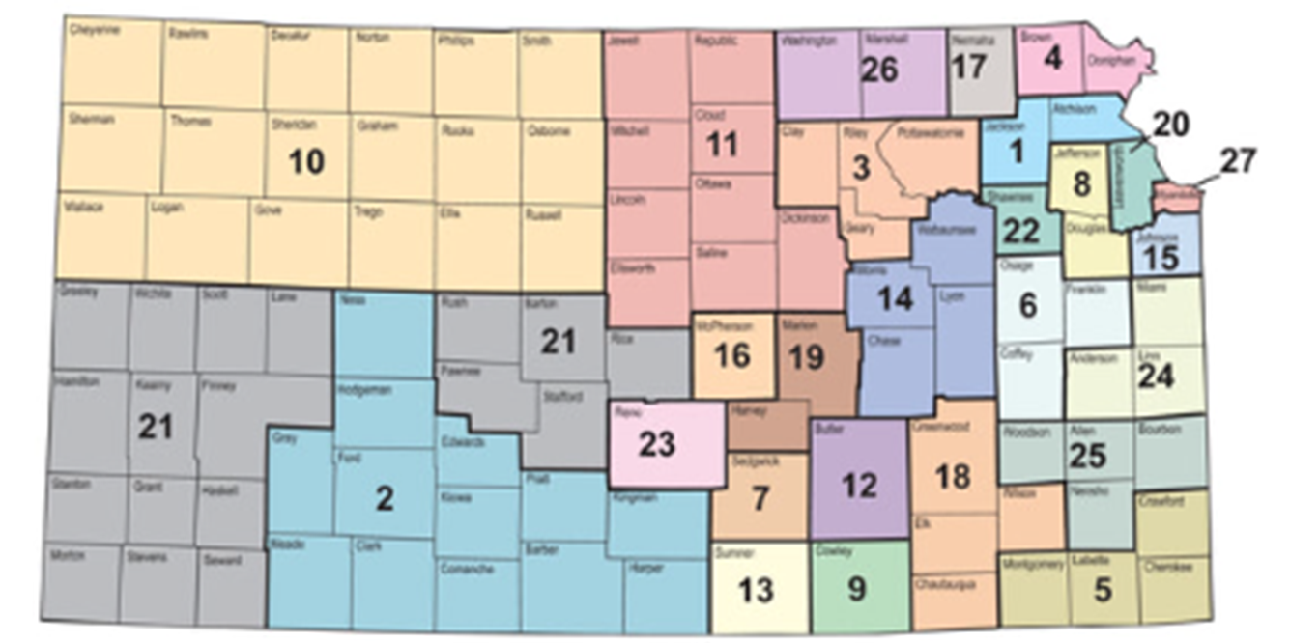
Kansas CDDO Map

Slide 30
Targeted Case Management
Families choose the agency or individual providing TCM
TCMs work with person to do person-centered support plan
Work with family to choose providers and monitor service provision
Interface with MCO Care Coordinator

Slide 31
When to Notify Your MCO Care Coordinator
Changes in the health of the person
Changes in the behaviors of the person
Changes in the health of the parent/guardian
Educational transitions
Need for a Waiver transition
Changes in Medicaid status
Involvement with Child/Adult Protective Services
Involvement with Law Enforcement
Involvement with the legal system

Slide 32
Changes in Medicaid Status
Changes in household income
  Family members’ wages, child support, etc.
  Person’s wages from employment
Entering/exiting foster care
Turning 18 years old
Receiving an inheritance
Receiving SSI
Receiving Survivor’s Benefits

Slide 33
DD Service Options
Use of the Service Access (Waiting) List
Use of Crisis Funding
Use of “Voluntary Placements” for children and youth under 22 years
Use of other service systems: social services; medical care; beneficiary programs

Slide 34
IDD Waitlist and Foster Care
Waitlist is currently over 8 years long
Person is not re-assessed once on the waitlist until the person is offered funding by KDADS
Can be by-passed by foster children for non-supervisory, disability-related support needs, or
Can be by-passed in crisis situations in order to avoid a child coming into custody (requires DCF/court documentation)
Can be by-passed in order for a child exiting custody to have identified disability support needs met.
Foster Care Exception requests go to the CDDO first, then to KDADS IDD Program Manager for review and determination.

Slide 35
IDD Crisis-Exception Requests
Requests are first made through the CDDO area in which the person lives (placement area)
Crisis requests based on APS/CPS, Law Enforcement, documented Abuse, Neglect, Exploitation (ANE), and/or
Significant, imminent risk to self, others
Community supports must first be exhausted before making a request (documentation required)
Cannot duplicate services already available, or services that should be provided by the foster parent.
CDDO approved requests then go to KDADS IDD Program Manager for review and determination

Slide 36
Self-Directed supports vs. agency-directed supports (in-home)
Children in custody must have agency-directed in-home supports.
In areas where no agency-directed supports are available for foster children, an exception for self-directed supports must go to KDADS IDD Program Manager for review and determination.
Children in Children’s Residential setting cannot also access in-home supports, as that constitutes a duplication of services

Slide 37
DD Waiver and Foster Care
IDD Waiver supports cannot be supervisory in nature for children in custody
Licensed Foster Care placements cannot have more than two children in the home unrelated to the IDD waiver participant in order for the child’s waiver to continue.
Any overpopulation request must happen prior to the home becoming overpopulated
All overpopulation requests related to a child’s waiver go to KDADS IDD Program Manager for review and determination.
Overpopulation requests start between CPA and DCF Licensing. Once DCF Licensing reviews, then goes to MCO. MCO makes request to IDD Program Manager.

Slide 38
Private Pay contracts for IDD adult services
18+ person in FC: private pay contract between CPA and IDD provider
Provider dependent on payment via private pay contract
Prior to ROC, exception access request needs to be initiated. TCM, MCO, DCF, CPA, CDDO, and KDADS all need to be involved.
Pre-planning for ROC needs to happen, and all parties need to be on the same page.

Slide 39
Children’s Residential: Licensed Foster Care setting for voluntarily placement
Can only have two children in the home not related to the IDD waiver participant.
Starts at age 5, ends at the latest, by the 22nd birthday
Must be located in or near the child’s home community (home county)
Any exception requests must go to KDADS IDD Program Manager for review and determination.
Cannot be used as a way to ROC a foster child.

Slide 40

Guardianship
Alternatives to Guardianship:
Limited guardianships
Power of Attorney
Conservatorship
Supported Decision Making*
Building in family and community/natural supports
* Kansas legislation pending

